Slide 1
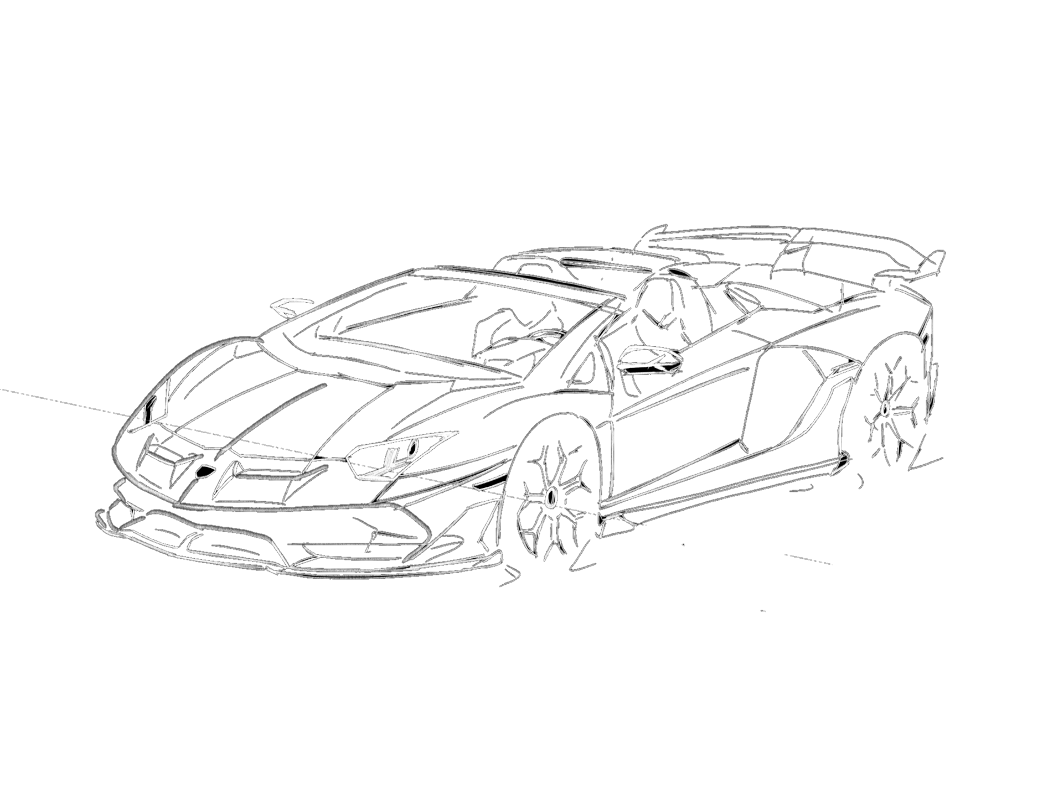
3D DESIGN PORTFOLIO
SELECTED WORK
BY MUKIL KUMAR
2023

Slide 2
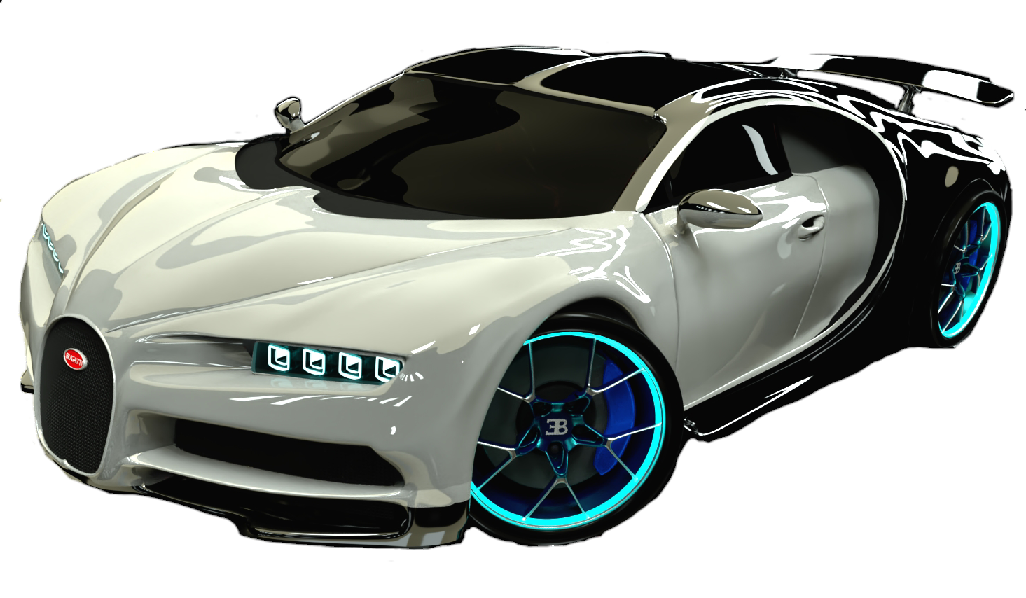
ABOUT CHIRON
The Bugatti Chiron is a luxury sports car designed and produced by Bugatti Automobiles S.A.S. The car is named after the French racing driver Louis Chiron. The Chiron's design was led by Bugatti's head designer Etienne Salomé, and is an evolution of the Veyron design. It features a sleek and aerodynamic body, with a long hood and a low, wide stance. The car's front fascia is characterized by its large, curved grille and LED headlights, while the rear features a distinctive LED light strip and a large, integrated spoiler. The Chiron's body is made of carbon fiber, which helps keep the car's weight down and improves its performance. The car's interior is also designed with luxury and performance in mind, with premium materials, advanced technology, and a minimalist design.
3D PROJECT #12

Slide 3
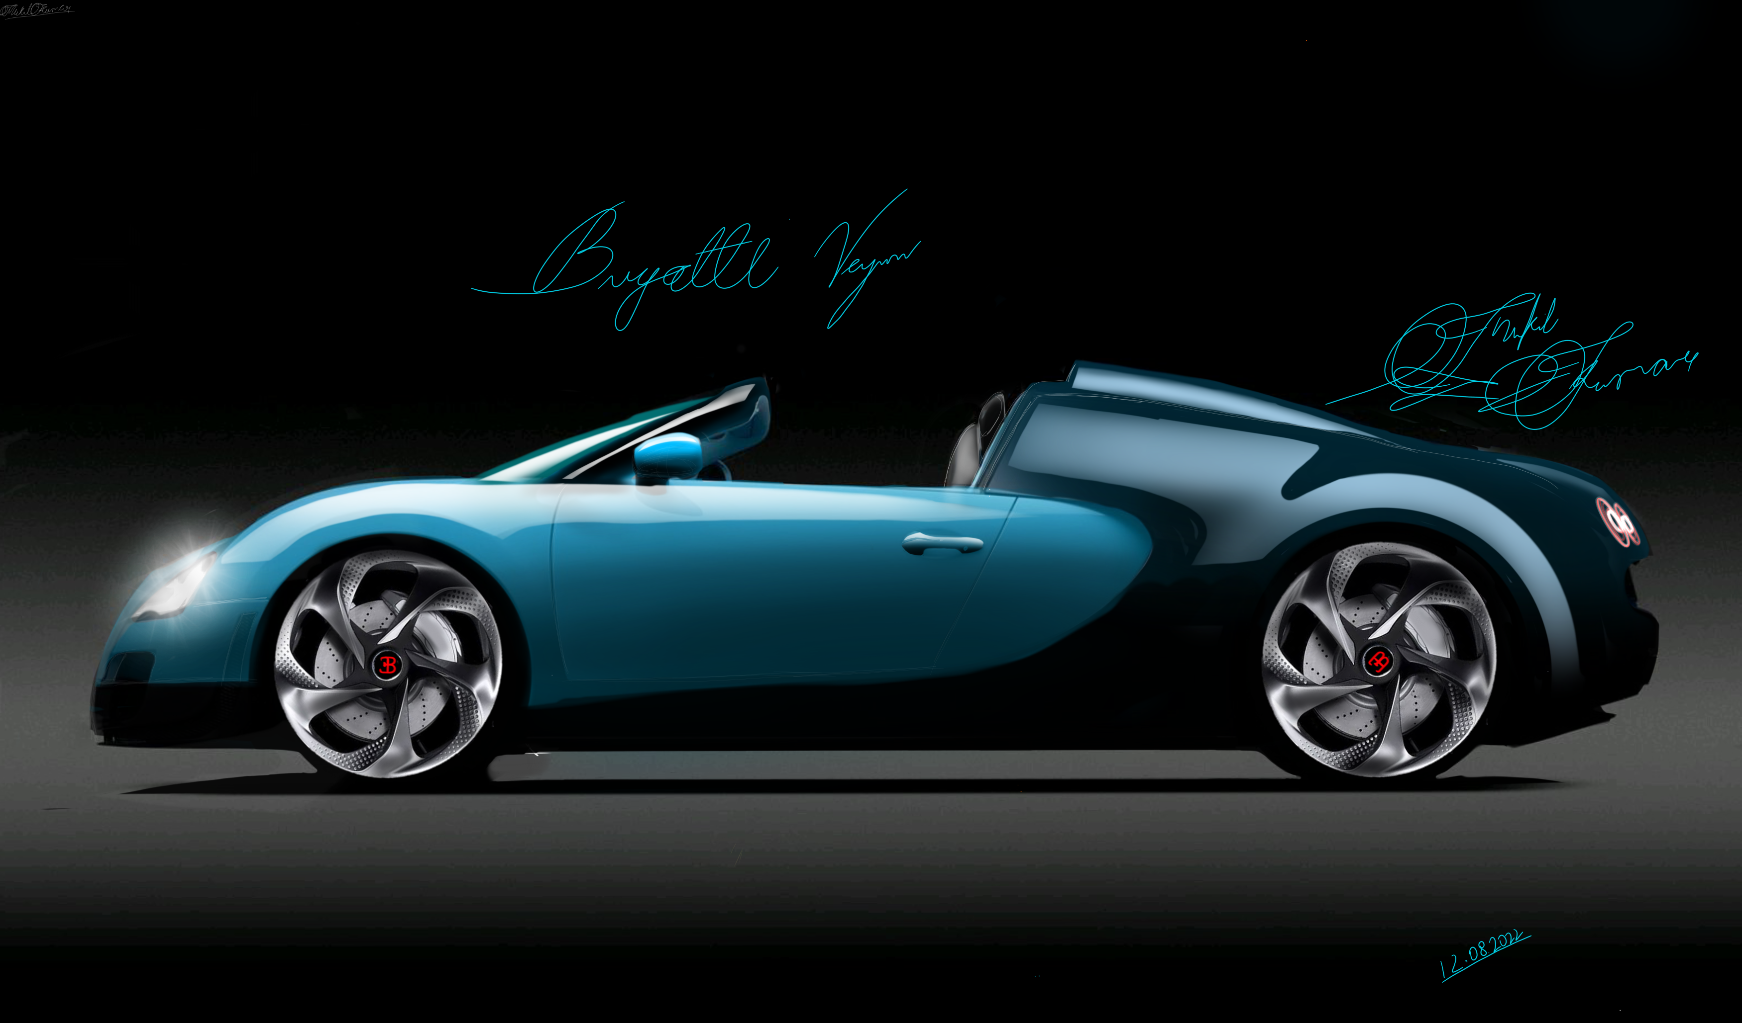
BUGATTI VEYRON
BUGATTI VEYRON DESIGN IS HEAVILY INFLUENCED BY THE COMPANY'S RACING HERITAGE

Slide 4
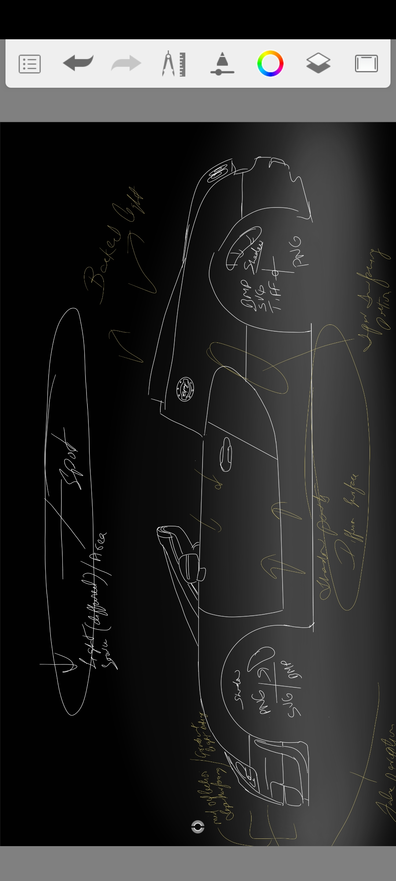
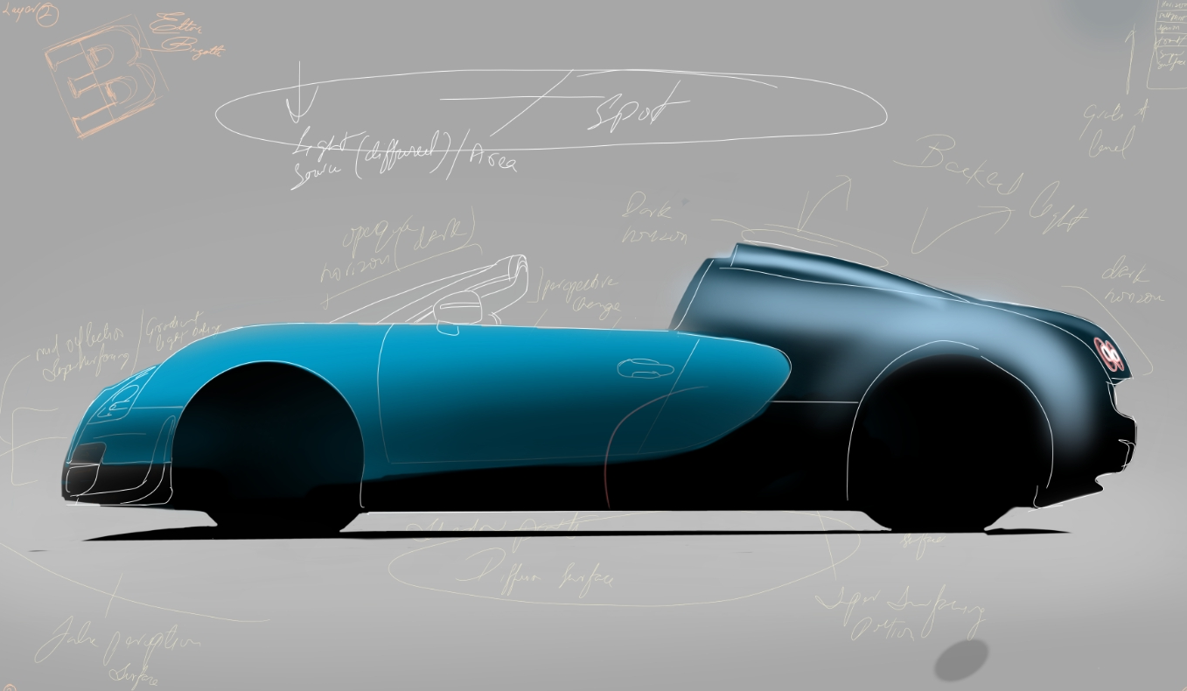
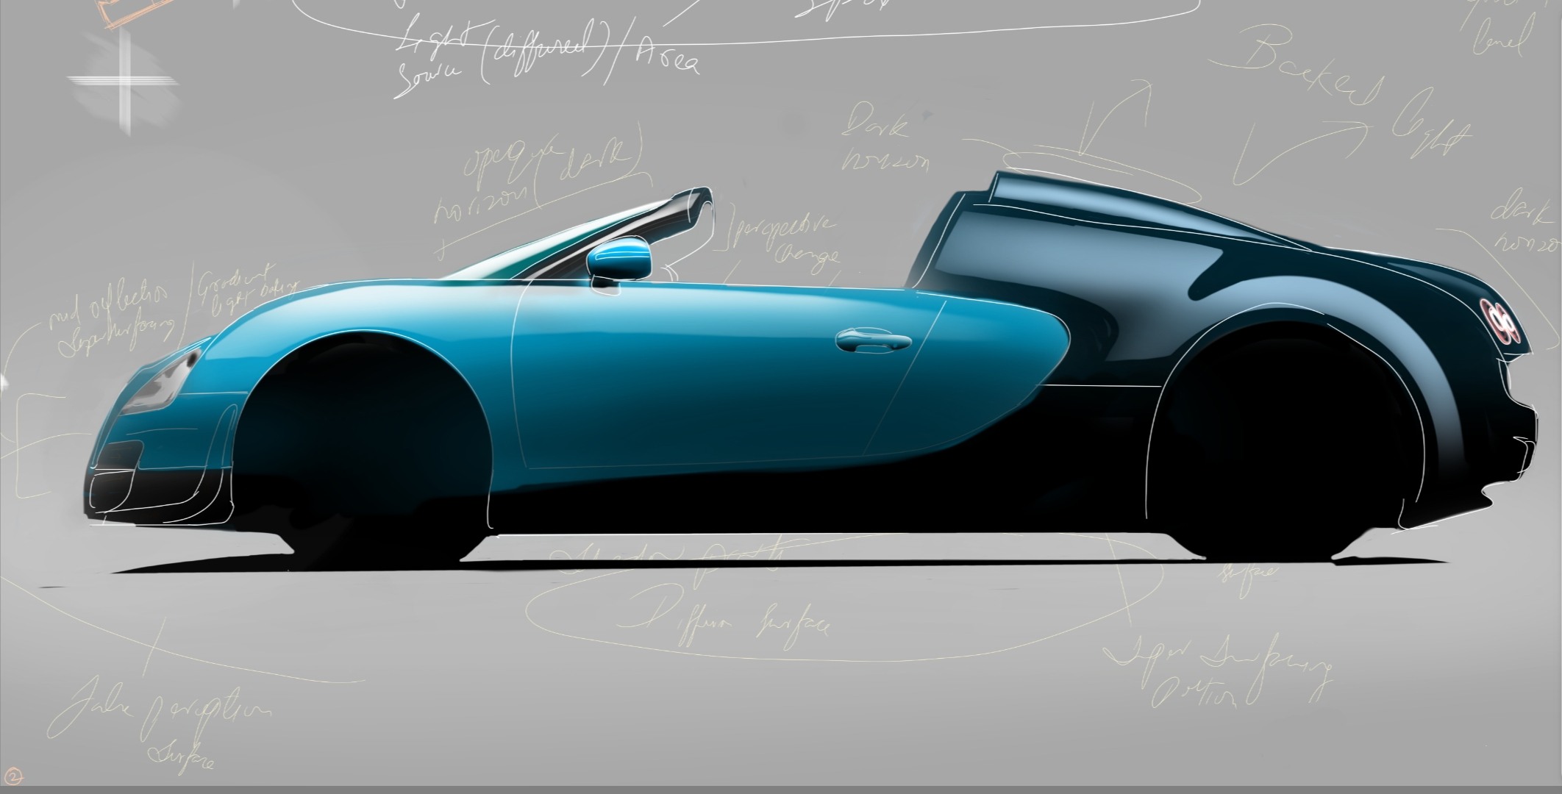
Four picture collage

Slide 5
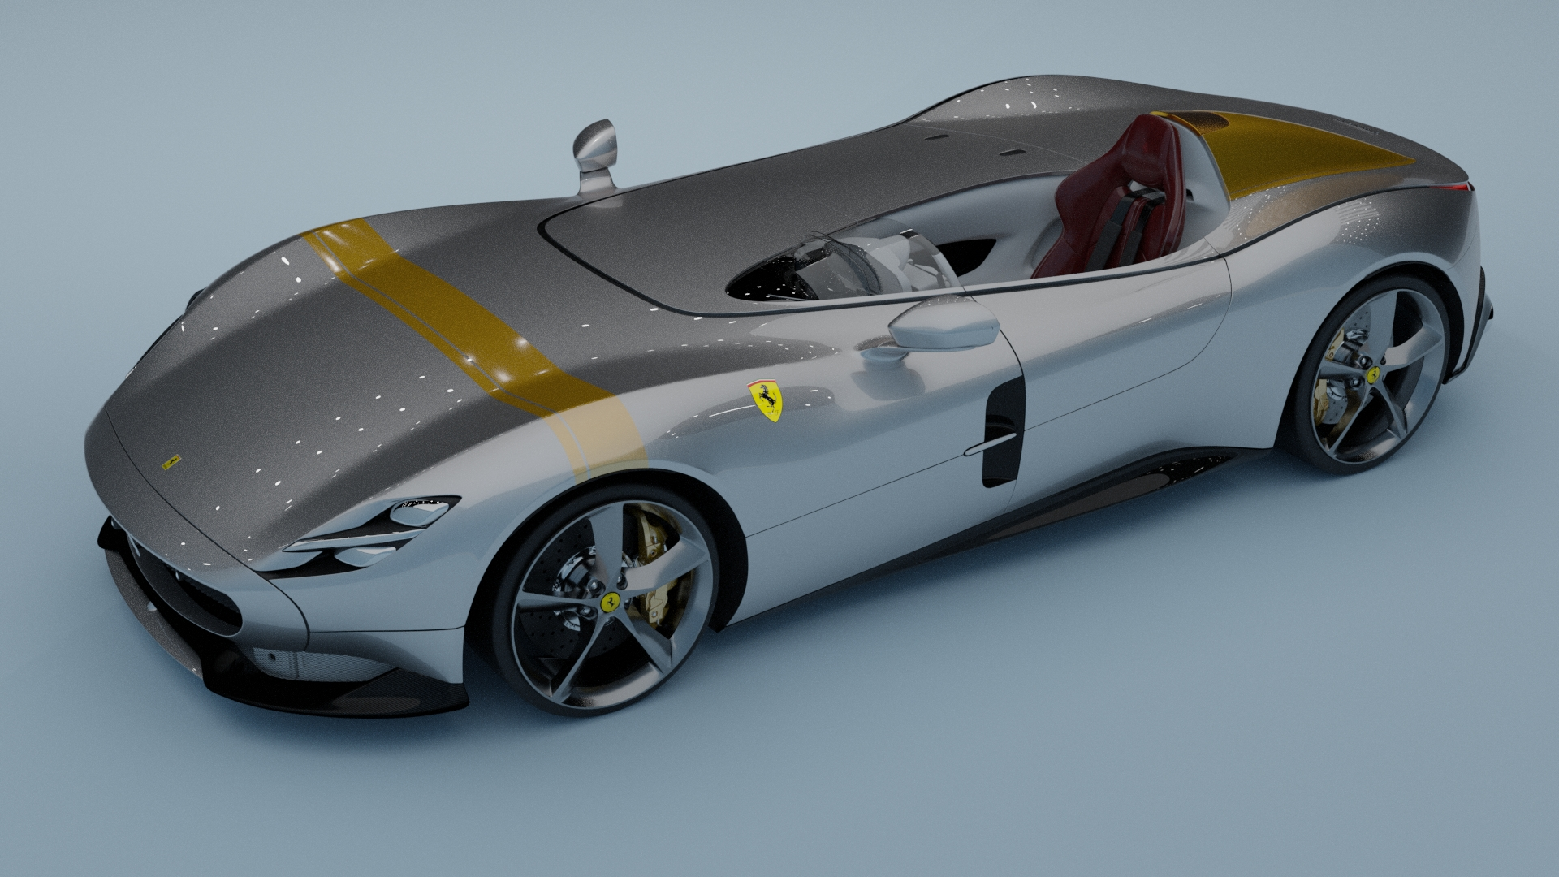
Ferrari
5
The Ferrari Monza SP1 is a limited edition model that was unveiled by Ferrari in 2018. It is part of the Icona series, which pays homage to some of the brand's most iconic models from the past. The design of the Monza SP1 is inspired by the barchetta body style, which was popular in the 1950s and features a sleek, open-top design with a minimal windshield and no roof.

Slide 6
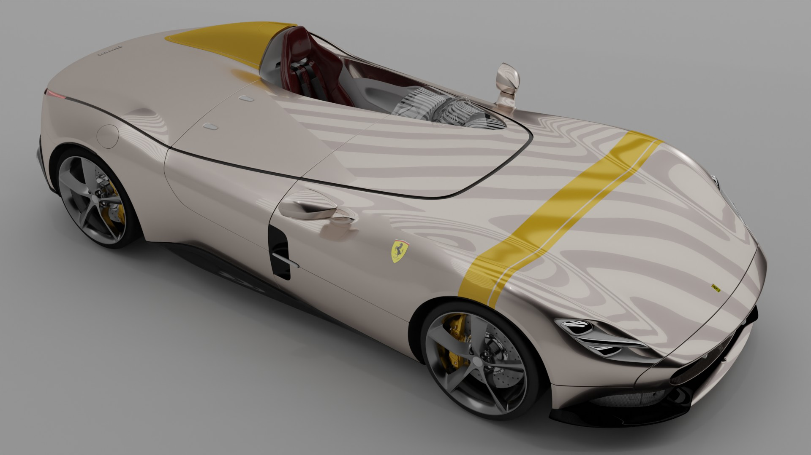
Ferrari
6
The Ferrari Monza SP1 is a limited edition model that was unveiled by Ferrari in 2018. It is part of the Icona series, which pays homage to some of the brand's most iconic models from the past. The design of the Monza SP1 is inspired by the barchetta body style, which was popular in the 1950s and features a sleek, open-top design with a minimal windshield and no roof.

Slide 7
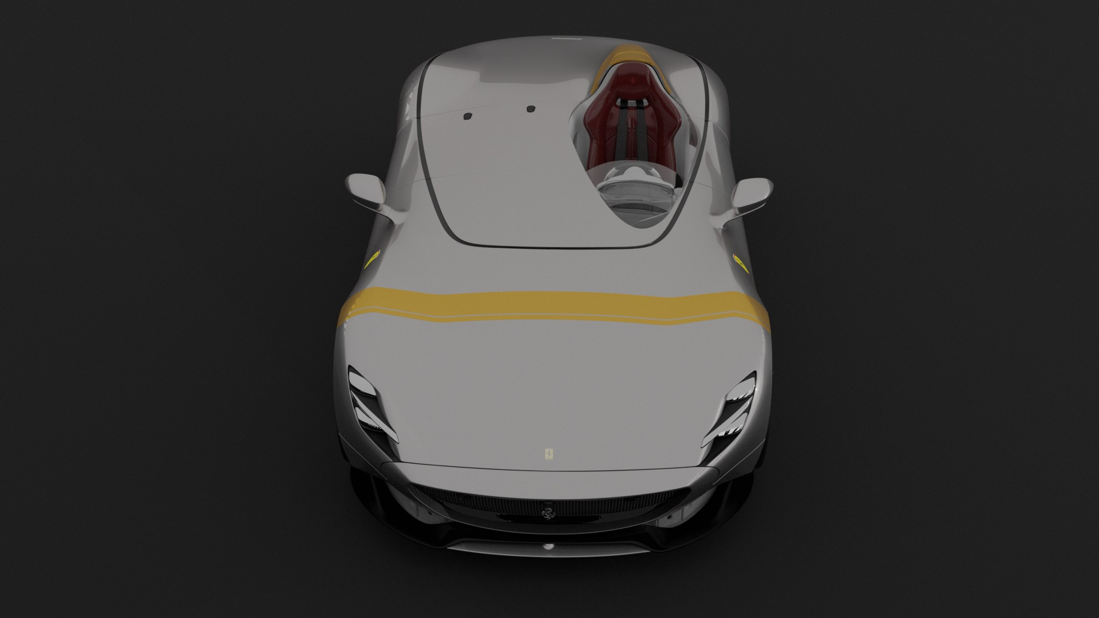
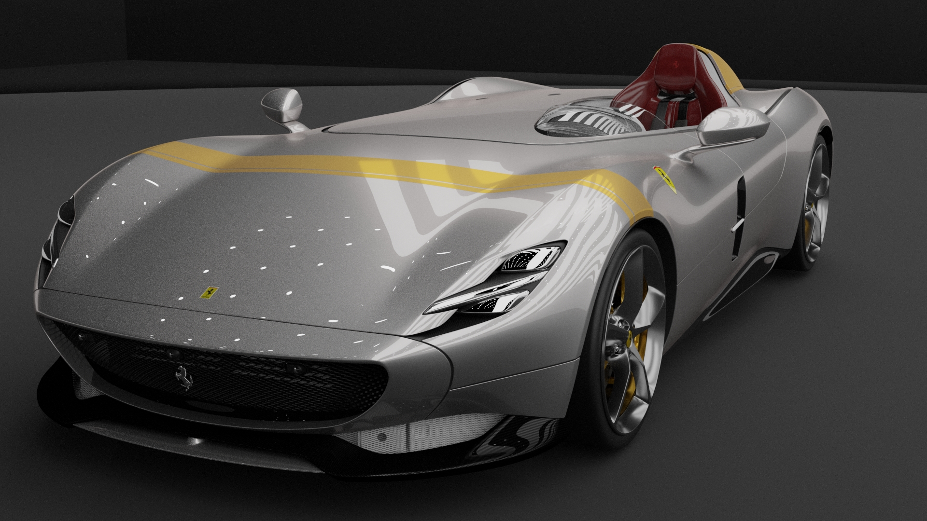
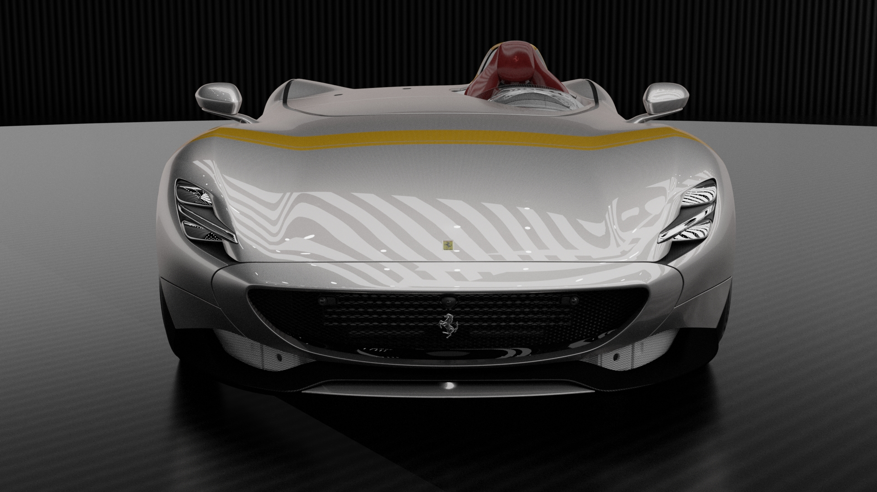
Three picture collage

Slide 8
RAVEN
AUTO ELETTRICA DI LUSSO, RAVEN

Slide 9
THANK YOU
mukil289446@gmail.com
+91-(933) 627 - 7706
www.mukil.vercel.app
www.mukilkum.myportfolio.com/work

